Slide 1
Sin, Sacrifice & Salvation

Slide 2
DISCUSSION
What do you understand by the term ‘sin’?
What does that word mean to you?

Slide 3
What is sin?
1) Any action or thought that separates humans from God
2) Behaviour which is against God’s laws and wishes or against principles of morality
Sins may refer to either individual sin (e.g. bad actions) or the state of sin (e.g. human tendency to choose evil)

Slide 4
Keywords
Original sin:
A doctrine that says that everyone is born with a built-in urge to do bad things and to disobey God; an important doctrine within the Catholic Church
Salvation:
Saving the soul, deliverance from sin and admission to heaven brought about by Jesus

Slide 5
Read the extract below
3 Now the serpent was more crafty than any other wild animal that the Lord God had made. He said to the woman, “Did God say, ‘You shall not eat from any tree in the garden’?” ² The woman said to the serpent, “We may eat of the fruit of the trees in the garden, ³ but God said, ‘You shall not eat of the fruit of the tree that is in the middle of the garden, nor shall you touch it, or you shall die.’ ” ⁴ But the serpent said to the woman, “You will not die, ⁵ for God knows that when you eat of it your eyes will be opened, and you will be like God, knowing good and evil.” ⁶ So when the woman saw that the tree was good for food and that it was a delight to the eyes and that the tree was to be desired to make one wise, she took of its fruit and ate, and she also gave some to her husband, who was with her, and he ate. ⁷ Then the eyes of both were opened

Slide 6

The origins of sin
Genesis 3 describes the story of Adam and Eve. Despite living in paradise, they sin against God by breaking an instruction from God. They ate from the fruit of the tree of the knowledge of good and evil (which they had been forbidden to do). This act introduced sin, evil and death into the world.
In Christian teaching, the sinfulness of Adam and Eve caused a separation from God that could result in humanity’s eternal punishment. This idea is referred to as original sin.
“Because you have listened to the voice of your wife, and have eaten of the tree about which I commanded you, ‘You shall not eat of it,’ cursed is the ground because of you; in toil you shall eat of it all the days of your life; thorns and thistles it shall bring forth for you; and you shall eat the plants of the field. By the sweat of your face you shall eat bread until you return to the ground, for out of it you were taken; you are dust, and to dust you shall return.” – Genesis 3: 17-19

Slide 7
Impact of sin
Many have interpreted the serpent that tempts Eve to eat the forbidden fruit to represent Satan (the Devil) who is seen as a force of evil
Only God is able to deal with the barrier caused by sin which He did through the incarnation & sacrificial death of Jesus
God in Christ offered salvation by cancelling out original sin and through the promise of eternal life

Slide 8
Put these events in order:
Trial before Jewish authorities; abandoned by disciples; Peter denies knowing him
Jesus’ enemies conspire to kill him; Judas betrays Jesus
Jesus enters Jerusalem
Jesus is arrested at Gethsemane
Trial before Pontius Pilate; declared guilty of treason and sentenced to crucifixion
Drives moneylenders out of the Temple
Jesus debates Sadducees, Pharisees and other Jewish religious leaders
Jesus holds final Passover meal with
12 disciples

Slide 9
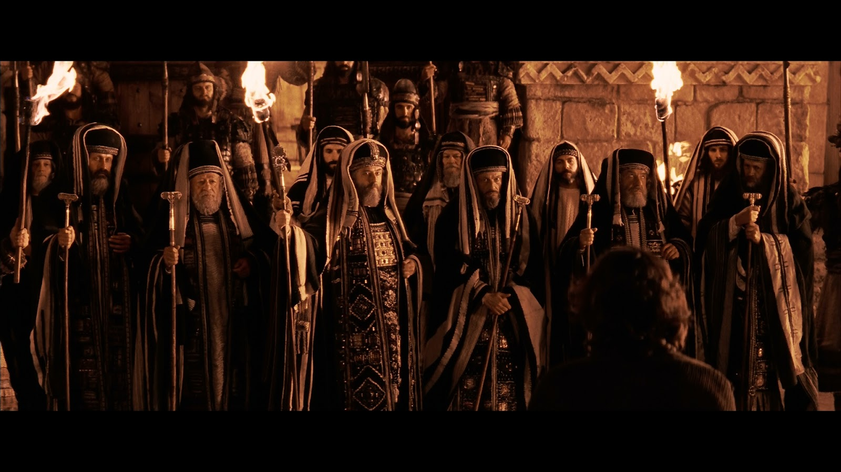
The Sanhedrin was a council that consisted of the powerful Jews in Israel – the High Priest and chief priests, Sadducees, scribes and Pharisees. It included teachers, priests and lawyers.

Slide 10
⁵³ They took Jesus to the high priest; and all the chief priests, the elders, and the scribes were assembled. ⁵⁴ Peter had followed him at a distance, right into the courtyard of the high priest; and he was sitting with the guards, warming himself at the fire. ⁵⁵ Now the chief priests and the whole council were looking for testimony against Jesus to put him to death; but they found none. ⁵⁶ For many gave false testimony against him, and their testimony did not agree.
⁵⁷ Some stood up and gave false testimony against him, saying, ⁵⁸ “We heard him say, ‘I will destroy this temple that is made with hands, and in three days I will build another, not made with hands.’” ⁵⁹ But even on this point their testimony did not agree. ⁶⁰ Then the high priest stood up before them and asked Jesus, “Have you no answer? What is it that they testify against you?” ⁶¹ But he was silent and did not answer. Again the high priest asked him, “Are you the Messiah, the Son of the Blessed One?” ⁶² Jesus said, “I am; and ‘you will see the Son of Man seated at the right hand of the Power,’ and ‘coming with the clouds of heaven.’” ⁶³ Then the high priest tore his clothes and said, “Why do we still need witnesses? ⁶⁴ You have heard his blasphemy! What is your decision?” All of them condemned him as deserving death. ⁶⁵ Some began to spit on him, to blindfold him, and to strike him, saying to him, “Prophesy!” The guards also took him over and beat him.

Slide 11
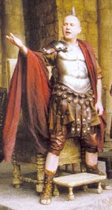
Pontius Pilate
Prefect of Judaea from 26-36 CE/AD
Described by two contemporary historians as being cruel – he was eventually removed from office for being so barbaric (quite an achievement for a Roman!)
As a representative of Rome he had the power to put people to death whereas the Sanhedrin would not
Pilate would not have been moved by the religious charge of ‘blasphemy’ – can you think why he might have been swayed to put Jesus to death?

Slide 12
Philo of Alexandria on Pilate
When Pilate, who was a man of inflexible, stubborn and cruel disposition, obstinately refused, they shouted: "Do not cause a revolt! Do not cause a war! Do not break the peace! Disrespect done to our ancient laws brings no honor to the emperor. Do not make Tiberius an excuse for insulting our nation. He does not want any of our traditions done away with. If you say that he does, show us some decree or letter or something of the sort, so that we may cease troubling you and appeal to our master by means of an embassy." This last remark exasperated Pilate most of all, for he was afraid that if they really sent an embassy, they would bring accusations against the rest of his administration as well, specifying in detail his venality, his violence, his thefts, his assaults, his abusive behaviour, his frequent executions of untried prisoners, and his endless savage ferocity. So, as he was a spiteful and angry person, he was in a serious dilemma; for he had neither the courage to remove what he had once set up, nor the desire to do anything which would please his subjects, but at the same time he was well aware of Tiberius' firmness on these matters.

Slide 13
15 As soon as it was morning, the chief priests held a consultation with the elders and scribes and the whole council. They bound Jesus, led him away, and handed him over to Pilate. ² Pilate asked him, “Are you the King of the Jews?” He answered him, “You say so.” ³ Then the chief priests accused him of many things. ⁴ Pilate asked him again, “Have you no answer? See how many charges they bring against you.” ⁵ But Jesus made no further reply, so that Pilate was amazed. ⁶ Now at the festival he used to release a prisoner for them, anyone for whom they asked. ⁷ Now a man called Barabbas was in prison with the rebels who had committed murder during the insurrection. ⁸ So the crowd came and began to ask Pilate to do for them according to his custom. ⁹ Then he answered them, “Do you want me to release for you the King of the Jews?” ¹⁰ For he realized that it was out of jealousy that the chief priests had handed him over. ¹¹ But the chief priests stirred up the crowd to have him release Barabbas for them instead. ¹² Pilate spoke to them again, “Then what do you wish me to do with the man you call the King of the Jews?” ¹³ They shouted back, “Crucify him!” ¹⁴ Pilate asked them, “Why, what evil has he done?” But they shouted all the more, “Crucify him!” ¹⁵ So Pilate, wishing to satisfy the crowd, released Barabbas for them; and after flogging* Jesus, he handed him over to be crucified.
Flogging – an extremely cruel method of punishment involving beating, typically with a whip or rod. There was no limit on the number of lashes that could be given and in some cases the flogging was so severe the prisoner died before they could be crucified. It may have been intended to shorten the time the criminal spent on the cross.

Slide 14
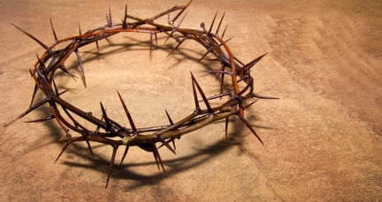
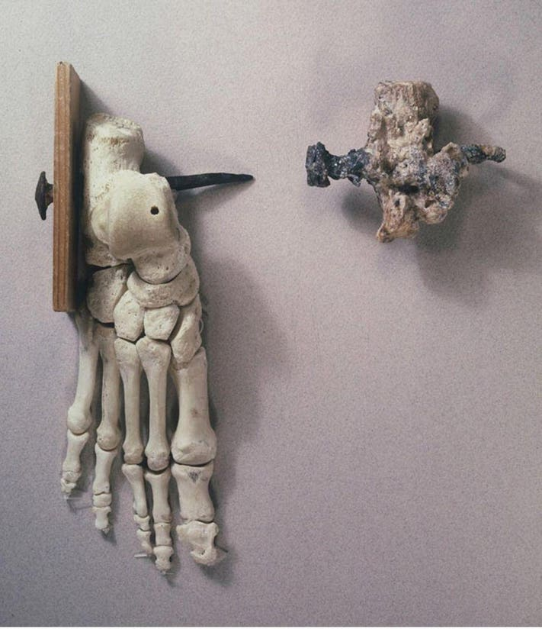
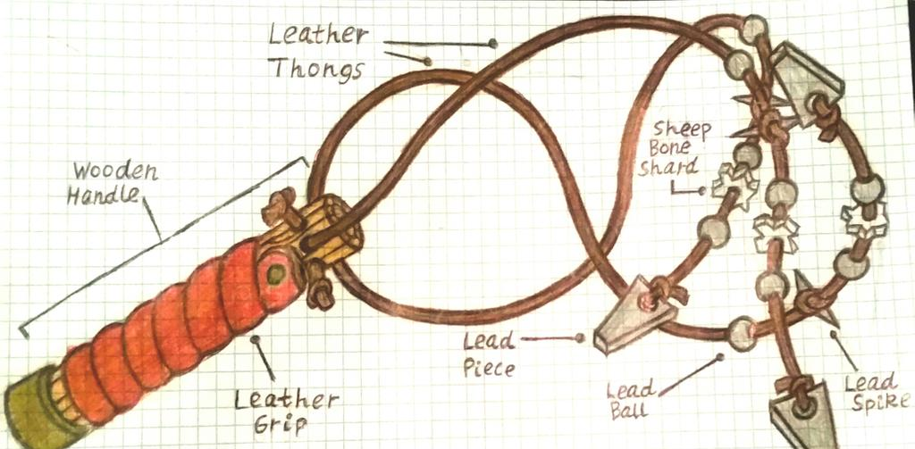

Slide 15
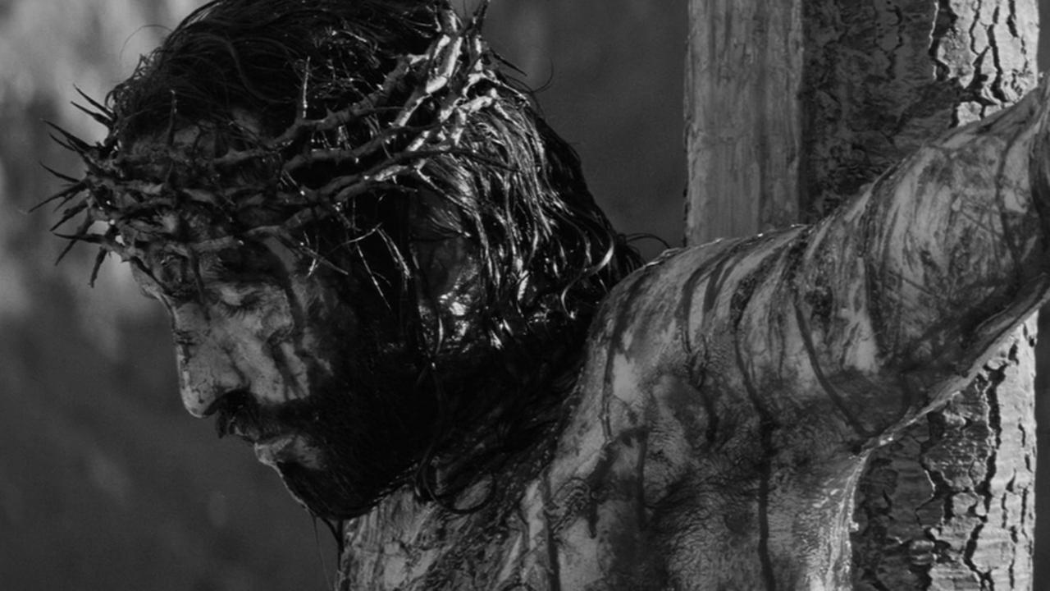
Jesus’ crucifixion
²⁵ It was nine o’clock in the morning when they crucified him. ²⁶ The inscription of the charge against him read, “The King of the Jews.” ²⁷ And with him they crucified two bandits, one on his right and one on his left. ²⁹ Those who passed by derided him, shaking their heads and saying, “Aha! You who would destroy the temple and build it in three days, ³⁰ save yourself, and come down from the cross!” ³¹ In the same way the chief priests, along with the scribes, were also mocking him among themselves and saying, “He saved others; he cannot save himself. ³² Let the Messiah, the King of Israel, come down from the cross now, so that we may see and believe.” Those who were crucified with him also taunted him.

Slide 16
The death of Jesus
³³ When it was noon, darkness came over the whole land until three in the afternoon. ³⁴ At three o’clock Jesus cried out with a loud voice, “Eloi, Eloi, lema sabachthani?” which means, “My God, my God, why have you forsaken me?” ³⁵ When some of the bystanders heard it, they said, “Listen, he is calling for Elijah.” ³⁶ And someone ran, filled a sponge with sour wine, put it on a stick, and gave it to him to drink, saying, “Wait, let us see whether Elijah will come to take him down.” ³⁷ Then Jesus gave a loud cry and breathed his last. ³⁸ And the curtain of the temple was torn in two, from top to bottom. ³⁹ Now when the centurion, who stood facing him, saw that in this way he breathed his last, he said, “Truly this man was God’s Son!”
⁴⁰ There were also women looking on from a distance; among them were Mary Magdalene, and Mary the mother of James the younger and of Joses, and Salome. ⁴¹ These used to follow him and provided for him when he was in Galilee; and there were many other women who had come up with him to Jerusalem.

Slide 17
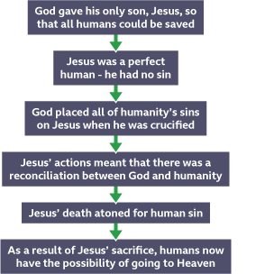
The idea of a sacrifice of one person making up for other people’s sins might be quite unfamiliar in the modern world
In the Old Testament, however, there are lots of examples of animals, such as lambs or goats, being ritually killed or sent out into the wilderness to make up for the sins of human beings (think ‘scapegoat’!)
Jesus is often referred to as the ‘Lamb of God’. This is because like a lamb, which would traditionally have been sacrificed, he died to make up for the sins of humanity

